Slide 1

EDA ON AIR_BNB DATA
BY
TEAM:GROUP ONE
SAFAWAT AL NASER

Slide 2

PROBLEM STATEMENT
For this project I collected Airbnb data of NYC during the year of 2019.. NYC is known for its diversity and most populist city in the USA. As the population is high and people visit this city to see its hotspots enormous amount, the urgency of booking hotel, room is more in this city.
My main object is to find out which are the key factors which are influencing its hotel business. Where Airbnb doing its main business. Whether public review affects its business or not.. What price are suitable for consumers and and relation between price and service fees and its effects on review and many more.
To understand the problem, I collected data of 2019 and worked on it.
I will find out the correlation among the data and will drop the data which I do not want for the analysis and will modify the data as needed.

Slide 3
Data understanding
Desired columns for analysis:
neighbourhood group
id
host id
Construction year
price
service fee
minimum nights
number of reviews
review rate number
host_identity_verified
instant_bookable
cancellation_policy
room type
last review 15234
There are 102598 observations
25 columns
Different types of data.
Consisting duplicate values.

Slide 4
Agenda
I tried to figure out some the answers to the question which is essential for our analysis.
Find out the percentage of duplicate values?
How to work on the null values?
Is there any outlier which could influence our analysis?
Which city has the greatest number of customers?
Which room type has more demand in term of business?
Among three cancelation policies which was mostly followed by hotel service?
What is the correlation between price and service fees?
In which year most of the accommodation arranged by Airbnb that means which year business grow more?
To Be Cont……

Slide 5
Agenda
Between 1-5 which review is mostly given by customer?
which city got the highest rated accommodations?
Which price range of accommodations customer prefers?
Does price is correlated with review by customers?
Does instant bookable option trigger review ?
What type of room type is mostly booked by customer and what was the review about this room type?

Slide 6
Working with duplicates, null and outliers:
There were 541 duplicate values which I removed.
Columns which null values filled up by their mean values given below:
reviews per month
service fee
Price
calculated host listings count
Null values fill by mode:
number of reviews
availability 365 null values means was no available room so filled up with the value 0
Other columns null values are not significant, so I removed that rows.
availability 365, minimum nights contains outliers which was taken care of.

Slide 7
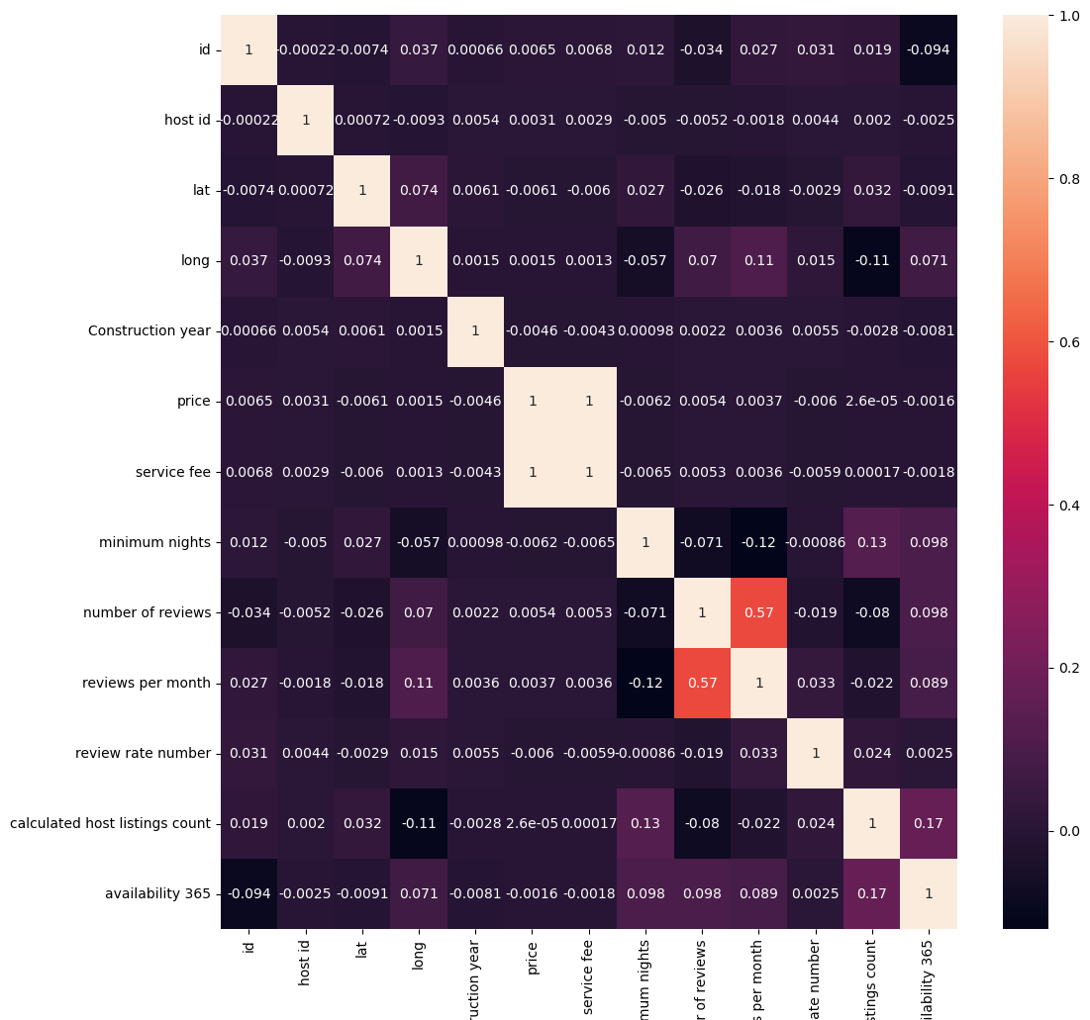
correlation
What factors which influenced review of customers?
There is no strong correlation between
any of the data as the correlation values are
Small.
So this correlation heat map will not help us
For analysis.
Have to look for other factor.

Slide 8
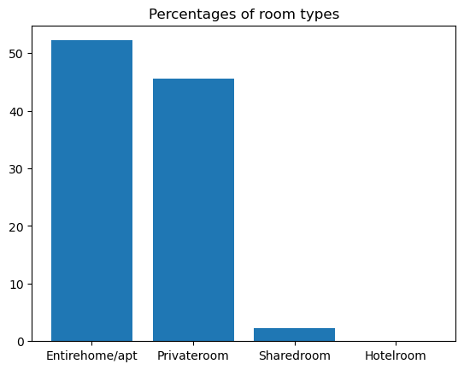
Which room type has more demand in term of business?
We can see 4 types of room available
Demand of apt is more than 50%.
Followed by private room which is almost 46%
Shared room and hotel room has less demand.

Slide 9
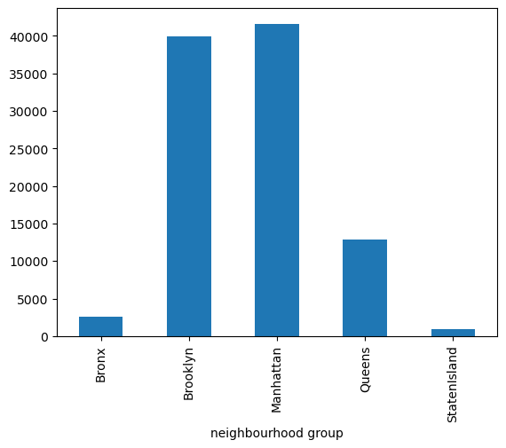
Which city has the greatest number of customers?
Five cities in New York state
Brooklyn and Manhattan got highest number of customers.
Queens is third in customer numbers
Lowest percentage in Staten island.

Slide 10
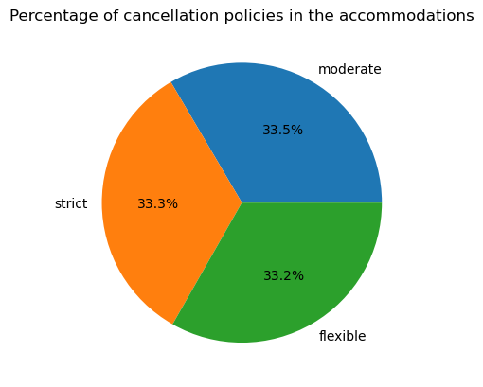
Among three cancelation policies which was mostly followed by hotel service?
3 types of policies strict, moderate, flexible.
In term of accommodation almost all consumer choose the same percentage of every policy.
Cancelation policies does not have any affects on accommodation choosing.

Slide 11
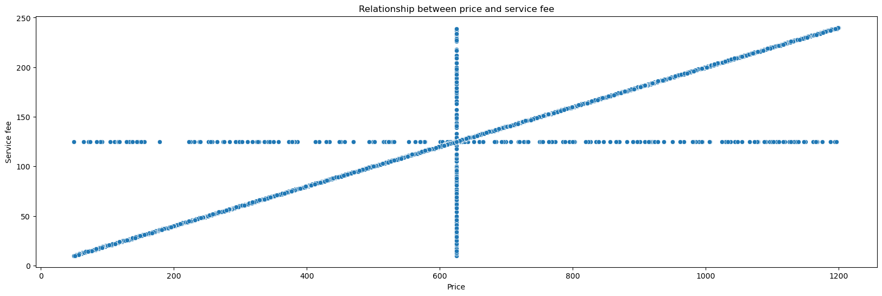
What is the correlation between price and service fees?
Price and service fees is strongly correlated.
Correlation is positive.
Where the price of rent is high , service fee also increase gradually.

Slide 12
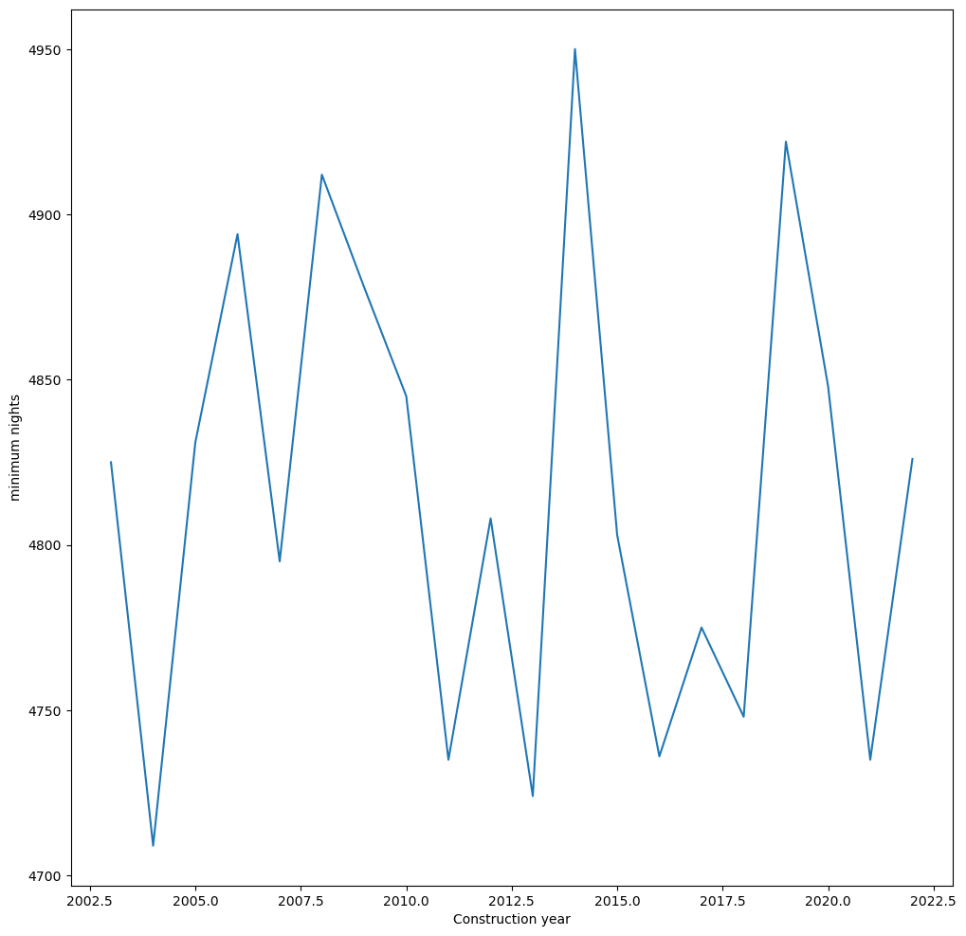
In which year most of the accommodation arranged by Airbnb that means which year business grow more?
From the data 2000 to 2022 I can see:
2014 is the year where most accommodation received from Airbnb
2004 is the lowest in this postion.

Slide 13
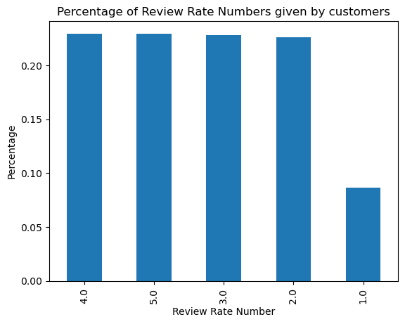
Between 1-5 which review is mostly given by customer?
Rating number between 1 to 5
People do not give lowest rating as much which is 1.
Though most people give the ratings 4
There was no difference in percentage of rating between 2 to 5.

Slide 14
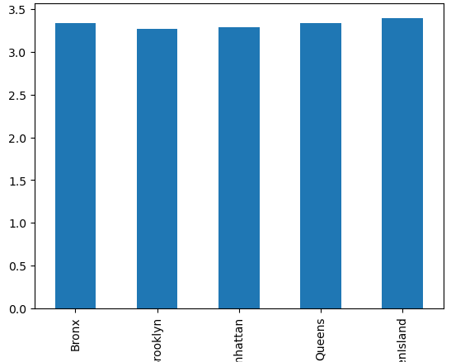
which city got the highest rated accommodations?
Five cities in NY state.
Average review rating between 3.2 to 3.4.
No difference in average rating in different city.

Slide 15
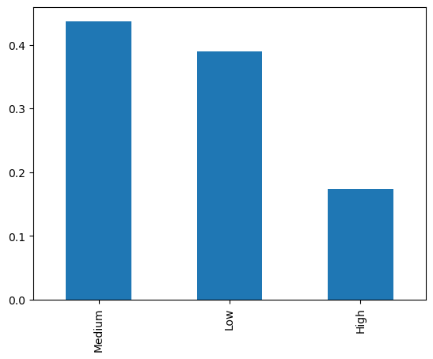
Which price range of accommodations customer prefers?
Price range divided into categories
Less than 500$ is low range
Between 501$-1000$ medium range.
More than 1000$ is high price range.
Medium range accommodation is very popular followed by low range accommodation.

Slide 16
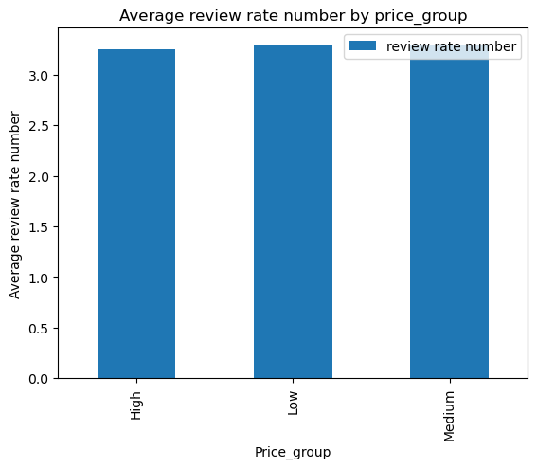
Does price is correlated with review by customers?
Average review for all type of price range almost same.
Between 3.1 to 3.3.
Customer does not care about how high the rent is, if the service is good they give good reviews.

Slide 17
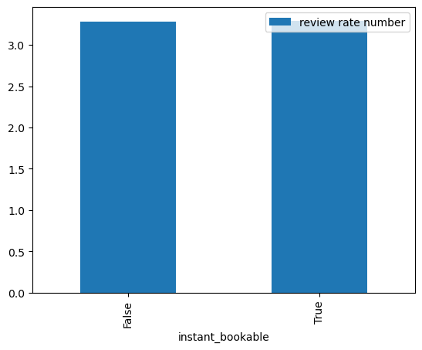
Does instant bookable option trigger review ?
For instant book two options available.
Instant bookable and not bookable instantly.
Both option have not much effects on customer reviews.

Slide 18
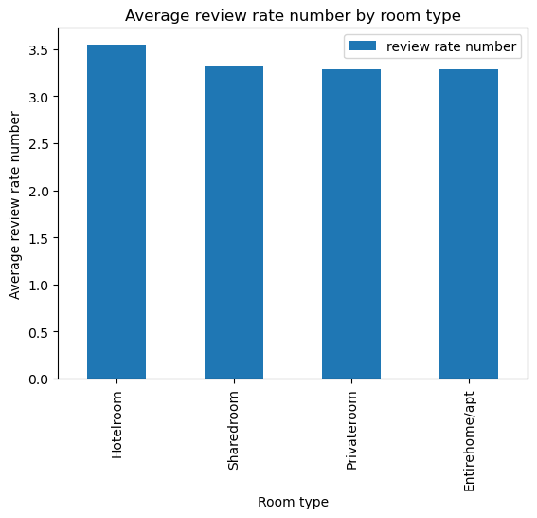
What type of room type is mostly booked by customer and what was the review about this room type?
For review hotel room got the highest average review. Because it is high price and service must be good also customer is less for it.
Shared room also got highest rated for customers
Private room and apt room got little less rating as the customers number are so high compared to other two types. As different types of service provider gave different service the rating is low as expected.

Slide 19
Recommendation:
As we can see Manhattan and Brooklyn has more than 50% of customer airbnb provided in NYC. This two place will be great for business expansion.
New build Airbnb should apt type or private room type as people rent this two types most.
To understand the relation, I recommended to use ML in this data which will give us more precise calculation.
As for the price and service fees relation need to use linear regression.
For the city based on cancellation policy, Instant bookable option, and room type which price should be set, to know this we can use multiclass regression.
For overall analysis of the data and bring the usable price for city decision tree algorithm will work well.

Slide 20


